Slide 1

Object oriented programming- instruement Rental Database Autumn Project Oluwamayowa Praise Ojofeitimi G00407342

Slide 2
What is Instrument Rental Application
My Rental application is a database that stores musical instruments from different families it stores their names, family, price aswell and brand. With use of crud within we are able to read, write, update and delete from from the tables

Slide 3
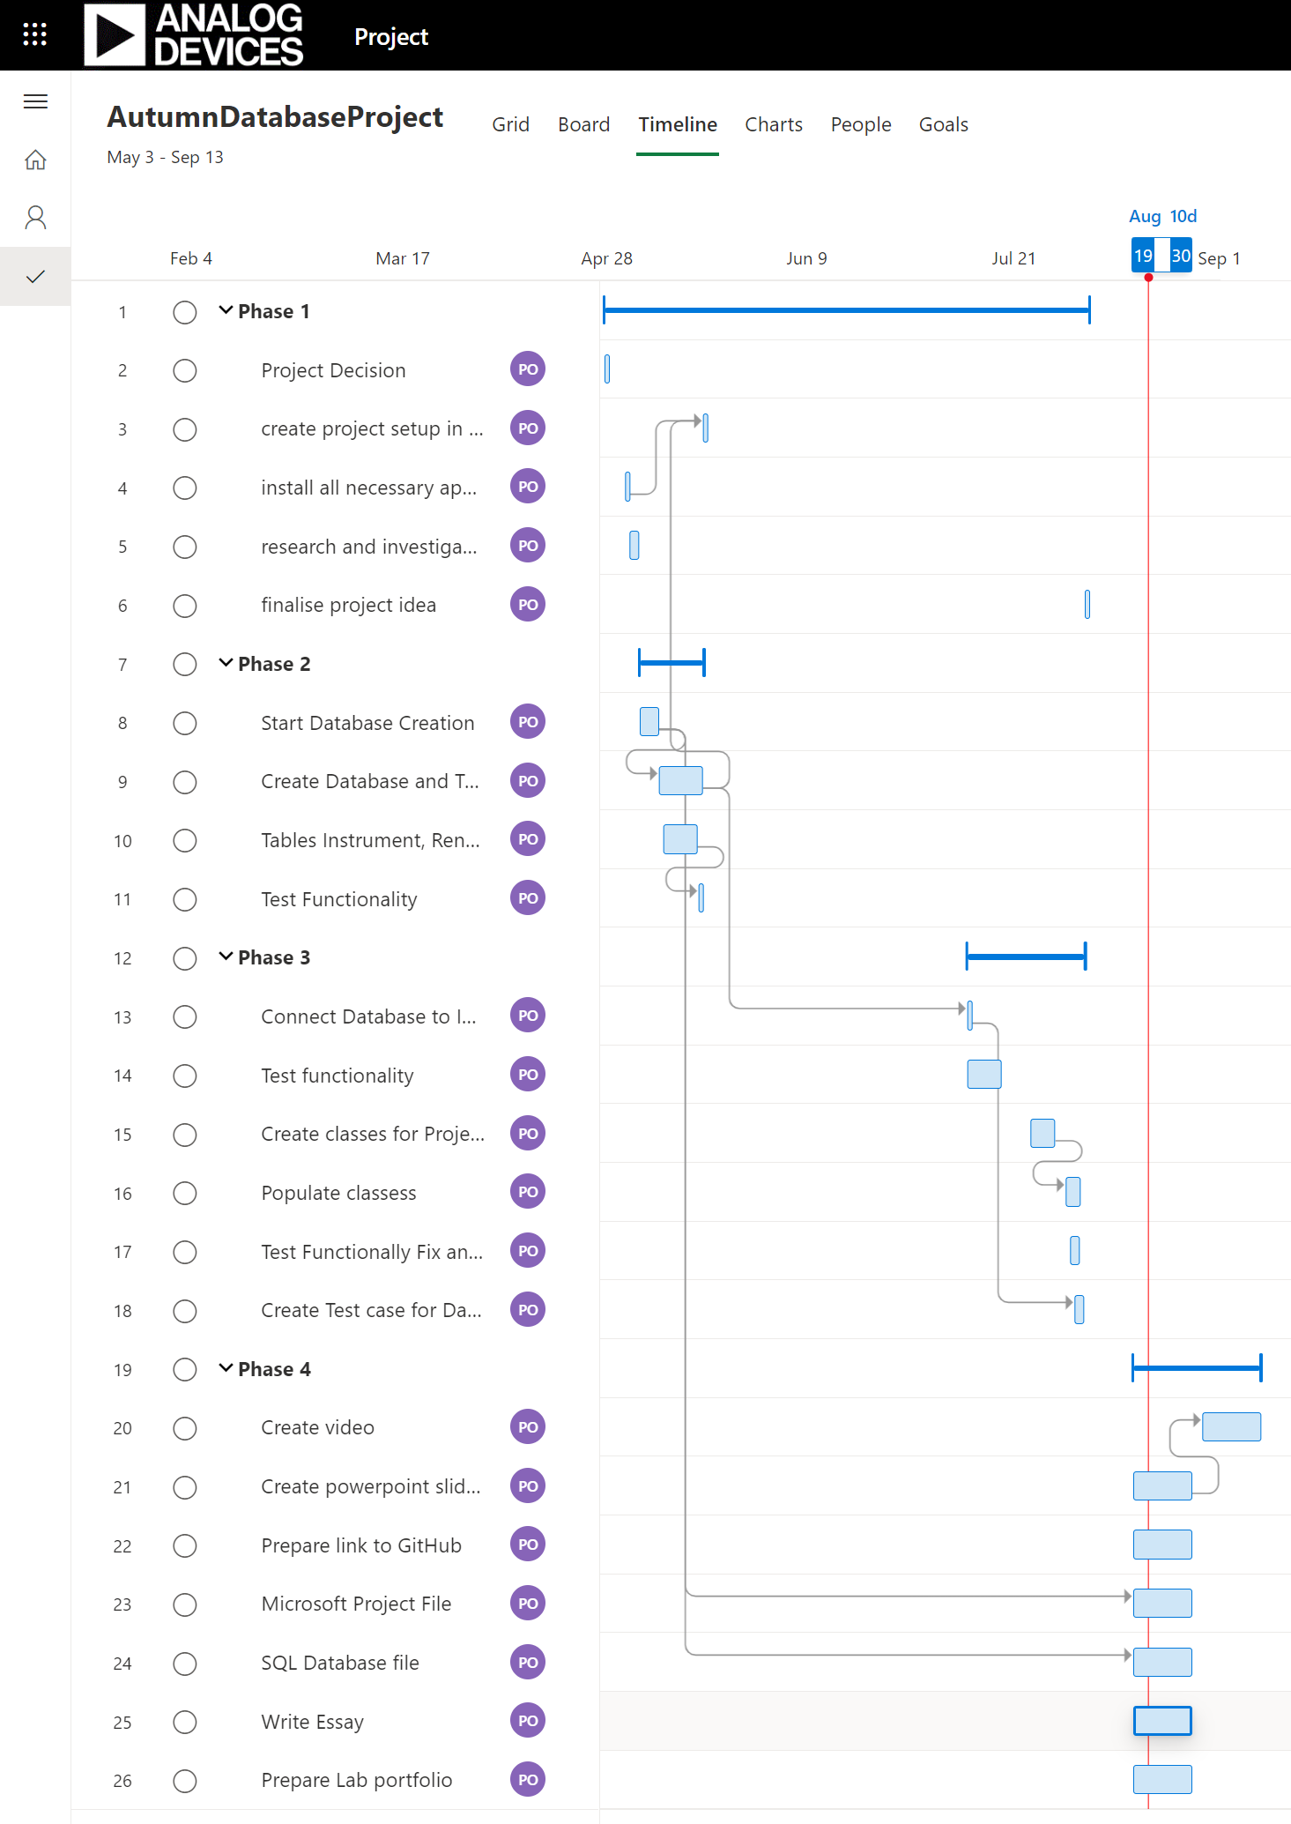
Gantt chart
I used Microsoft Project to assign myself tasks and deadlines for these tasks

Slide 4
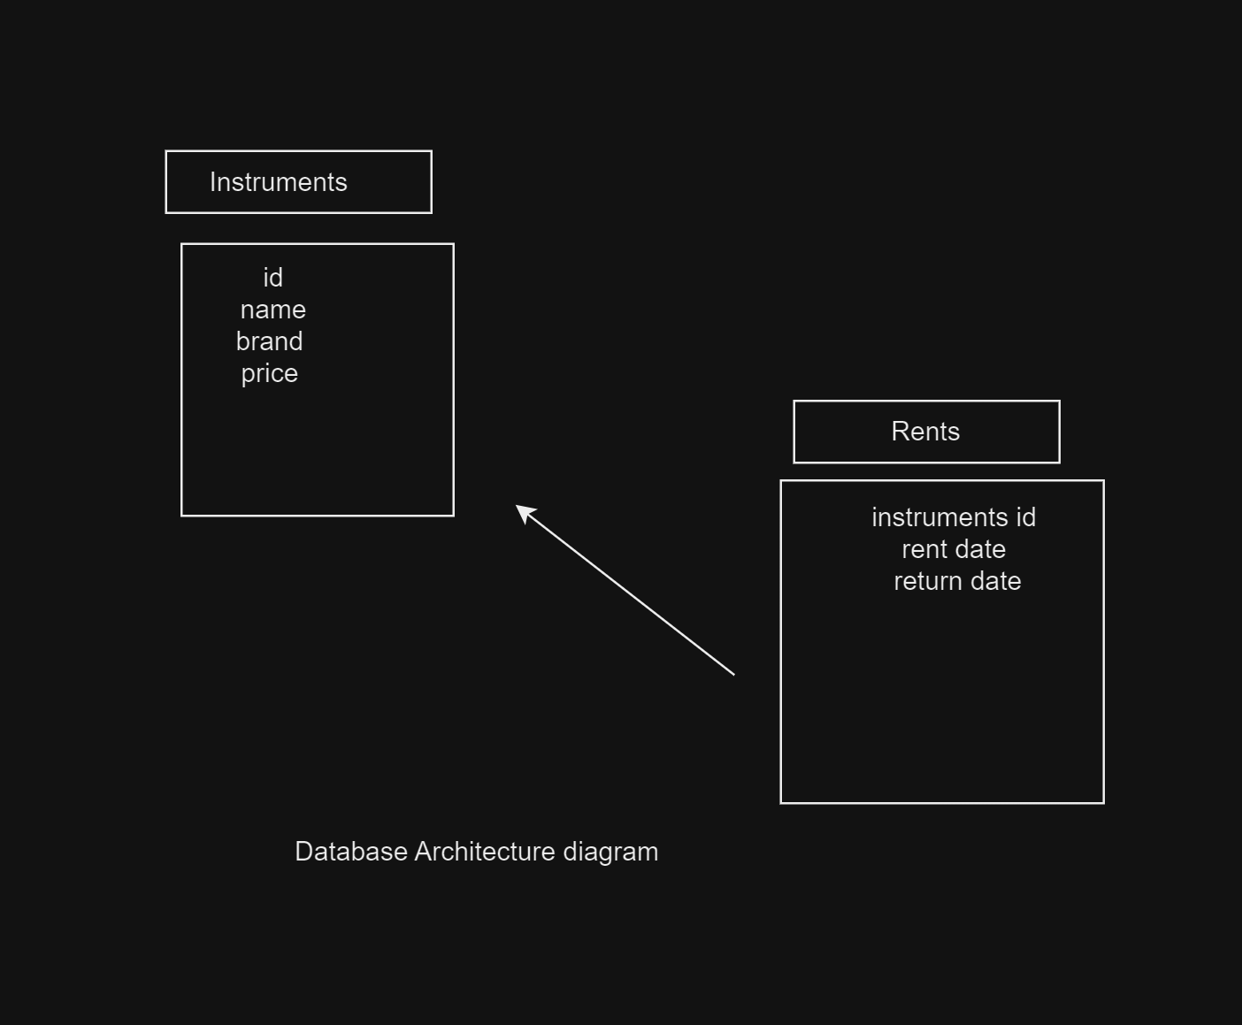
Database normalisation
I normalised the database in two tables rents and instruments
These two tables connect with primary and foreign.n keys

Slide 5
Research?
Mostly I used lecture notes and assignments to recap on the necessary work need e.g. JDBC notes.
I did individual research on databases and connecting them. Aswell as research on project ideas that fit the project description

Slide 6
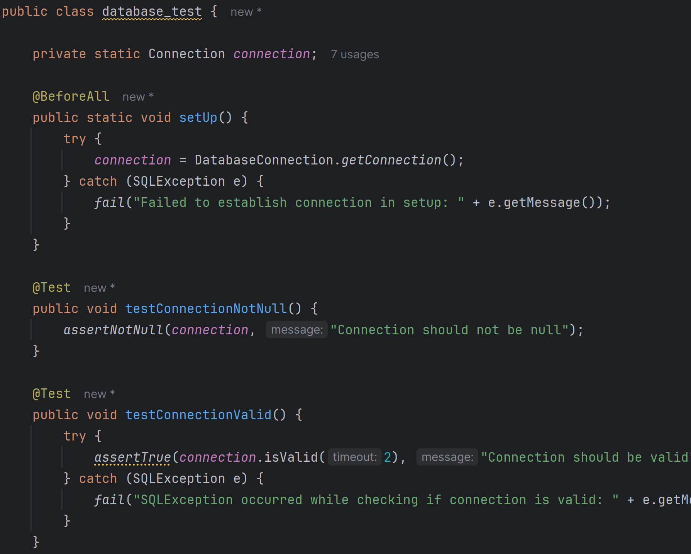
testing
My project includes also a test class in order to test the actually classes within the project in order to see if the function and are doing as expected

